Slide 1
Twitter Data Analytics – Analyzing Tweet Networks
Bychapura Parameswaraiah, Chandan (cbp140230)
Jiang, Ran (rxj131530)
Kuncham, Venkata Keerthana (vxk142230)

Slide 2
Phases of the Project
Data Collection
Tweets for a Query String
Tweet collection for an “EVENT”
TOPIC modeling and Tweets collection for a TOPIC
LDA algorithm
Tweets collection for a “TOPIC”
Friend and Followers data
Friend/ Follower information for each user
Limited by the number of API Twitter API calls which can be made
Collected approximately 200 friend/followers for each user
User’s history re-tweets data
History re-tweet information for each user
Limited by the number of API Twitter API calls which can be made
Collected approximately 30,000 history retweets for each user
For the sample data chosen, utilized up to 35MB data.

Slide 3
Phases of the Project
Data Analysis
Information Propagation Graph (extracting most important people in a re-tweet network)
Degree Centraity
EigenVector Centrality
Betweenness Centrality
Modeling timeline for Tweets (Persistence and Visibility Decay of tweets)
Sampling
Sentiment Analysis for tweets

Slide 4
Data Analysis
Tweet Data Composition
ailtonqw40|670712857928081408|Sat Nov 28 15:16:21 GMT-06:00 2015|null|null|-1|1|<a href="http://twitter.com/download/android" rel="nofollow">Twitter for Android</a>|RT @AdvisorAbbate: Two weeks after the terrorist attack, #Paris mourns the 130 victims of attacks https://t.co/wiUGKClMbD
Twitter Data | What it Specifies
Ailtonqw40 | Twitter User IDs
670712857928081408 | Tweet ID
Sat Nov 28 15:16:21 GMT-06:00 2015 | Tweet Posted Date
RT @AdvisorAbbate: Two weeks after the terrorist attack, #Paris mourns the 130 victims of attacks https://t.co/wiUGKClMbD | RT – Specifies it is a retweet @User – Original User ID And the Actual Tweet Message

Slide 5
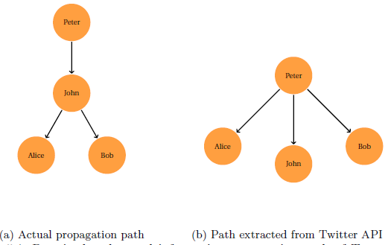
DATA Analysis
Modeling information propagation graph for the Retweets
“RT @Peter: Full-time: Chelsea 3-1 Steaua Bucharest. (3-2 on agg) and we’re through to the quarter-finals. #CFC”

Slide 6
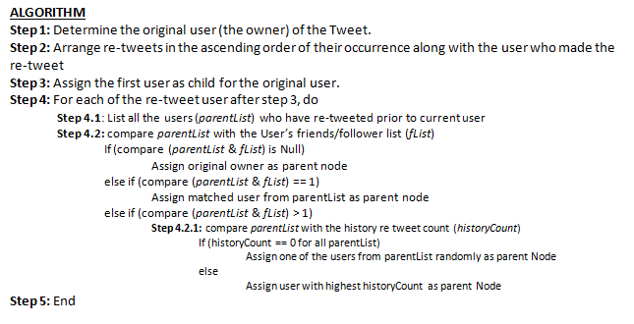
Algorithms
Information Propagation Graph

Slide 7
RE-tWEET NETWORK – An Example
A |12345|Sat Nov 28 15:16:06 GMT-06:00 2015|Josh Homme Raising Money
B | 23456|Sat Nov 30 15:16:07 GMT-06:00 2015|RT @A : Josh Homme Raising Money
C | 87654|Sat Nov 30 13:14:01 GMT-06:00 2015|RT @A : Josh Homme Raising Money
D | 23212|Sat Dec 1 13:11:03 GMT-06:00 2015|RT @A : Josh Homme Raising Money
E | 21234|Sat Dec 1 13:13:03 GMT-06:00 2015|RT @A : Josh Homme Raising Money
F | 98762|Sat Dec 1 13:14:01 GMT-06:00 2015|RT @A : Josh Homme Raising Money
B
C
A
D
E
F

Slide 8
RE-tWEET NETWORK – An Example
Nov 30 13:14:01
Dec 1 13:11:03
Nov 28 15:16:06
Friends List
B -> A
C -> A
D -> A,C
E -> A, C
F -> C
Retweet History in the order
D -> C,A
E -> C,A
A
C
D
B
E
F
Nov 30 15:16:07
Dec 1 13:13:03
Dec 1 13:14:01

Slide 9
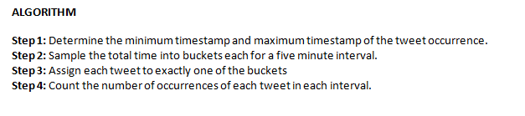
Algorithms
Time Line Modeling
Sentiment Analysis
Bag of Words Strategy

Slide 10
Technologies
MALLET: open source tool for LDA algorithm. Used this tool for topic modeling
Twitter APIs (OAuth): to crawl twitter social media and collect the real time tweets data and user information.
Rest Web Service: to communicate with twitter server
Apache Spark: for data processing and analytical result derivation.
Cassandra: for row by row result set data processing.

Slide 11
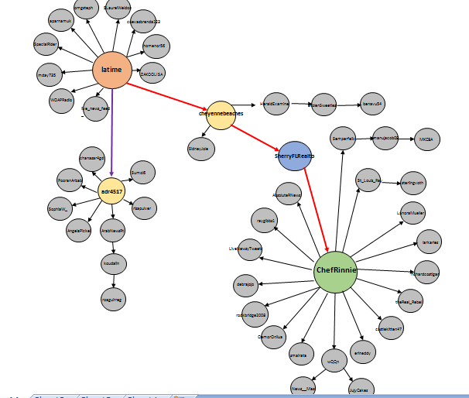
OUTPUT VIZUALIZATION

Slide 12
OUTPUT VIZUALIZATION

Slide 13
Thank you !!

